Slide 1
Retail Insights Assistant
GenAI + Scalable Data System
By: Fardeen Alam

Slide 2
System Design for 100GB+ Data Scale

Slide 3
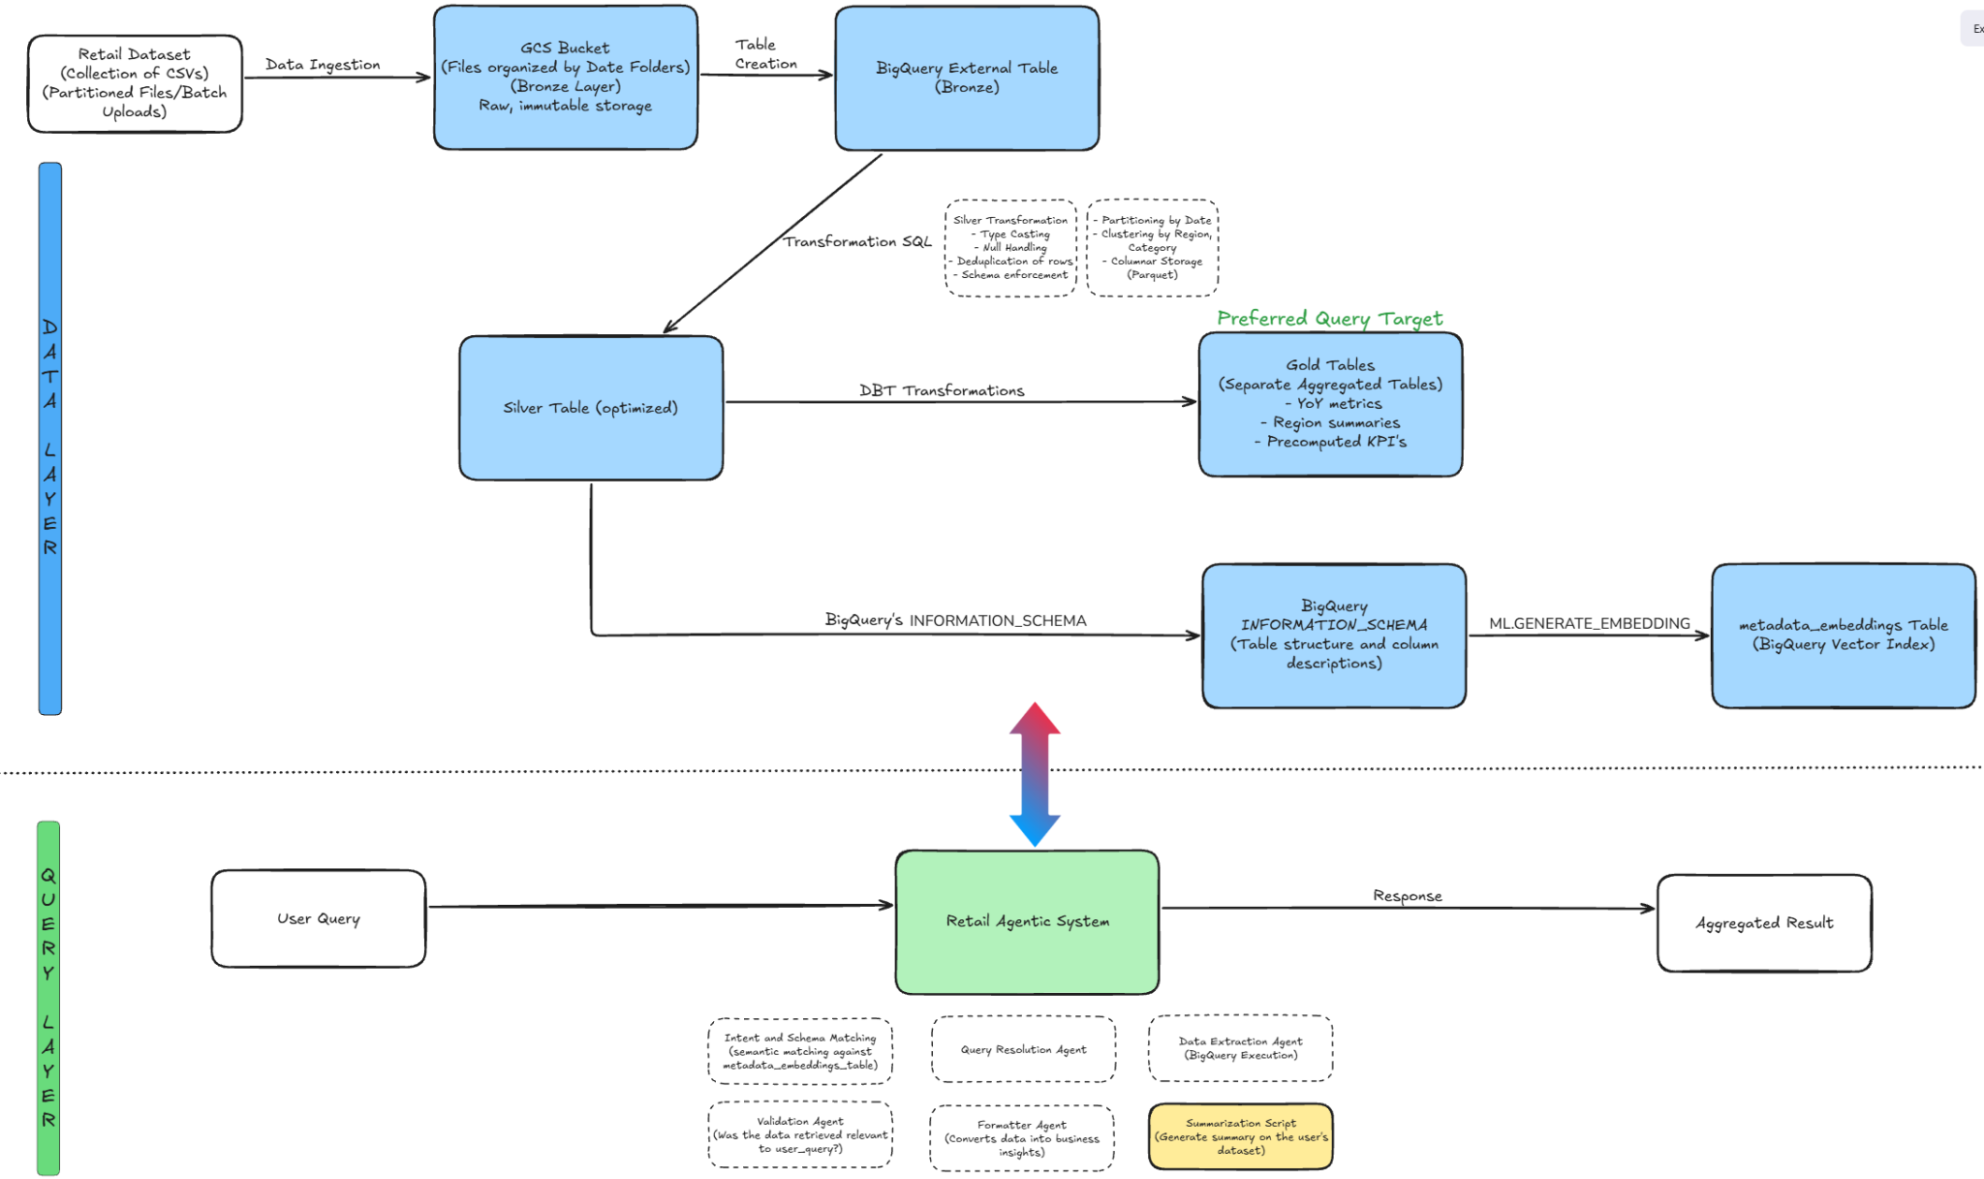

Slide 4
Core Tool Selections for the Data Layer
Google Cloud Storage (GCS) - Scalable Data Lake
Role: Acts as the Bronze (Raw) Layer; stores immutable 100GB+ datasets at a fraction of the cost of database storage.
Key Choice: Enables Decoupled Ingestion; BigQuery can query these files directly via External Tables without the need for complex, manual loading scripts.
BigQuery - Serverless Data Warehouse
Role: Powers our Silver (Cleaned) and Gold (Aggregated) layers.
Key Choice: Serverless Scaling handles massive joins without cluster management. Native BigQuery ML Vector Search enables the "Retail Assistant" to perform semantic retrieval directly where the data lives.
dbt (Data Build Tool) - SQL Transformation
Role: Orchestrates the transformation from Silver -> Gold.
Key Choice: Brings Software Engineering to SQL (Version control, testing, and modularity). Ensures the data feeding the LLM is high-quality, deduplicated, and business-validated.

Slide 5
Architecture Techniques: Data Layer Optimization
Medallion Architecture (Bronze -> Silver -> Gold)
Strategy: Multi-stage data refinement.
Benefit: Bronze preserves raw data integrity; Silver provides a cleaned "Single Source of Truth"; Gold stores high-level aggregates for instant, low-cost summary generation.
Table Partitioning (Time-Based Sharding)
Strategy: Physically dividing the 100GB table by Order_Date.
Benefit: When the Assistant queries a specific month, BigQuery ignores 90%+ of the dataset, slashing query costs and latency significantly.
Table Clustering (Multi-Column Sorting)
Strategy: Sorting data within partitions by high-frequency filters like Region or Category.
Benefit: Physically co-locates related data, allowing for lightning-fast "drill-down" queries (e.g., "Sales for Electronics in the North").
BigQuery Vector Indexing
Strategy: Creating an embedding-based index on table metadata and product/column descriptions.
Benefit: Enables Semantic Retrieval; the agent can find relevant columns or products based on "meaning" rather than just exact keyword matches.

Slide 6
Retail Agentic System Architecture (100GB+)

Slide 7
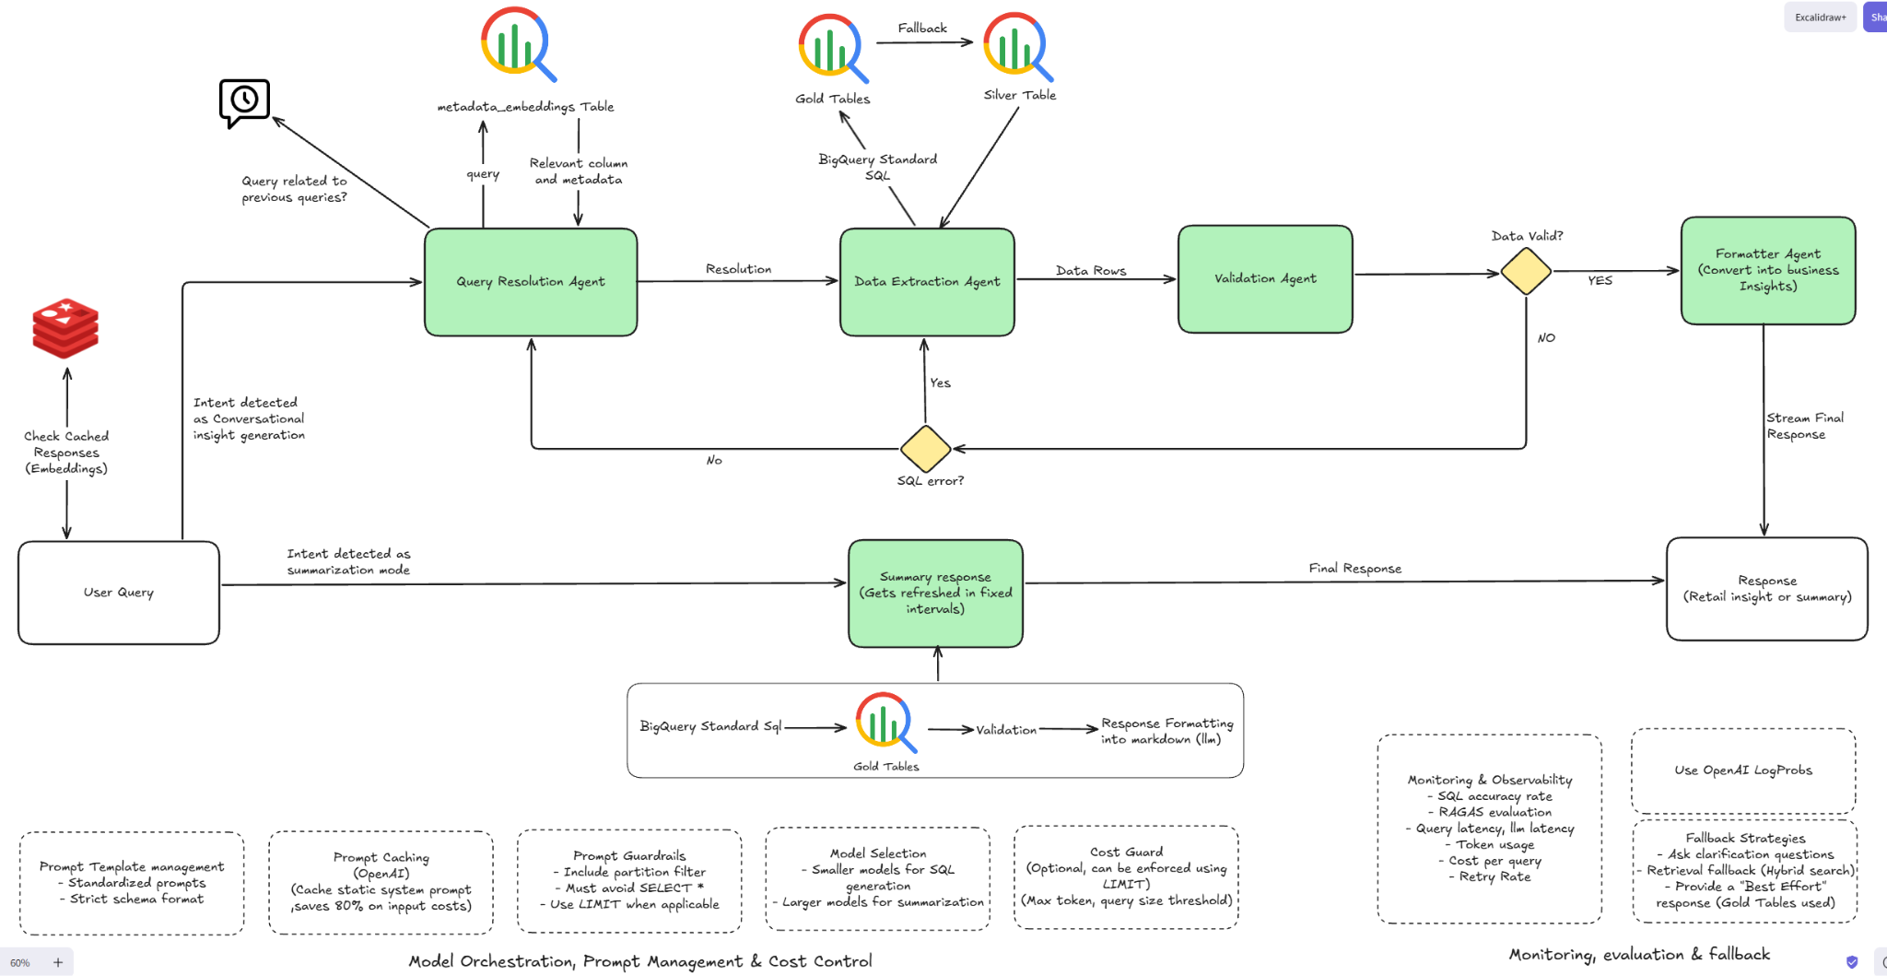

Slide 8
Agentic Layer: Scaling & Orchestration
LangGraph Orchestration (Stateful Multi-Agent Workflow)
Technique: Uses a cyclic, state-based graph to manage agent handovers.
Scale Benefit: Prevents "hallucination loops" by using a Validation Agent as a circuit breaker to catch and fix incorrect SQL before execution.
Semantic Context Caching
Technique: Bolds and caches the massive 100GB schema metadata in the LLM's context window.
Scale Benefit: Reduces latency and cuts token costs by up to 80% by reusing schema definitions across multiple user queries.
Metadata-Driven Schema Linking
Technique: Agents perform a Vector Search on table metadata (not the raw data) to identify relevant columns.
Scale Benefit: Allows the LLM to navigate thousands of partitions and hundreds of columns without exceeding context limits or scanning irrelevant data.
Automated Partition Injection
Technique: The Extraction Agent is hard-coded to require date/region filters derived from the user query.
Scale Benefit: Ensures every generated SQL query is "Scale-Aware," preventing expensive and slow Full Table Scans on the 100GB dataset.

Slide 9
System Architecture and data flow for MVP
(Current System)

Slide 10
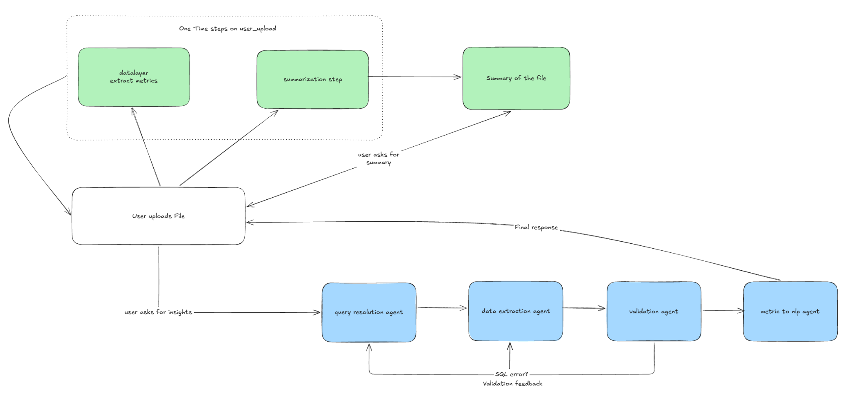

Slide 11
Query-Response Pipeline

Slide 12
Data Ingestion & Automated Summarization
Data Layer (DuckDB & GCS Integration):
Action: User uploads CSV via Streamlit; data is loaded into an in-memory DuckDB table for high-performance processing.
Profiling: Runs a full schema scan (dtypes, null counts, min/max/avg) to produce a TableProfile.
Metadata Grounding:
Action: Serializes the profile into a Structured Metadata Context (cardinality, sample values, ranges).
Benefit: Injects this context into every agent prompt, ensuring the LLM is "grounded" in the actual dataset.
Summarization Pipeline (Parallel Processing):
Query Planning: LLM generates 8-12 diverse SQL queries (totals, trends, top-N) based on metadata.
Synthesis: Executes queries in DuckDB and synthesizes results into a Markdown Executive Report (Executive Summary, Key Metrics, Trends).

Slide 13
Conversational Multi-Agent Q&A Workflow
Query Resolution Agent (The Planner):
Converts user questions into a structured Query Spec (intent, filters, aggregations).
Maintains Conversation Memory (last 5 turns) to handle follow-up questions efficiently.
Data Extraction Agent (The Coder):
Translates the spec into precise DuckDB SQL and executes it.
Automatically handles upto 200MB scale through optimized SQL generation.
Validation Agent (The Quality Gate):
Audits the SQL and results against the user's intent.
Self-Correction: Triggers up to 3 independent retries by routing back to either the Planner (for logic errors) or Coder (for SQL errors).
Formatter Agent (The Analyst):
Transforms raw table rows into concise, business-friendly natural language answers.

Slide 14
Evidence

Slide 15
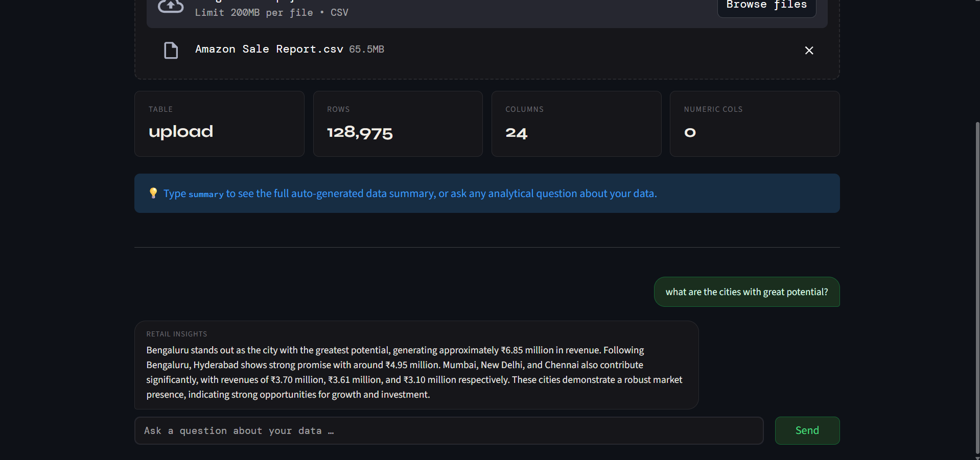

Slide 16
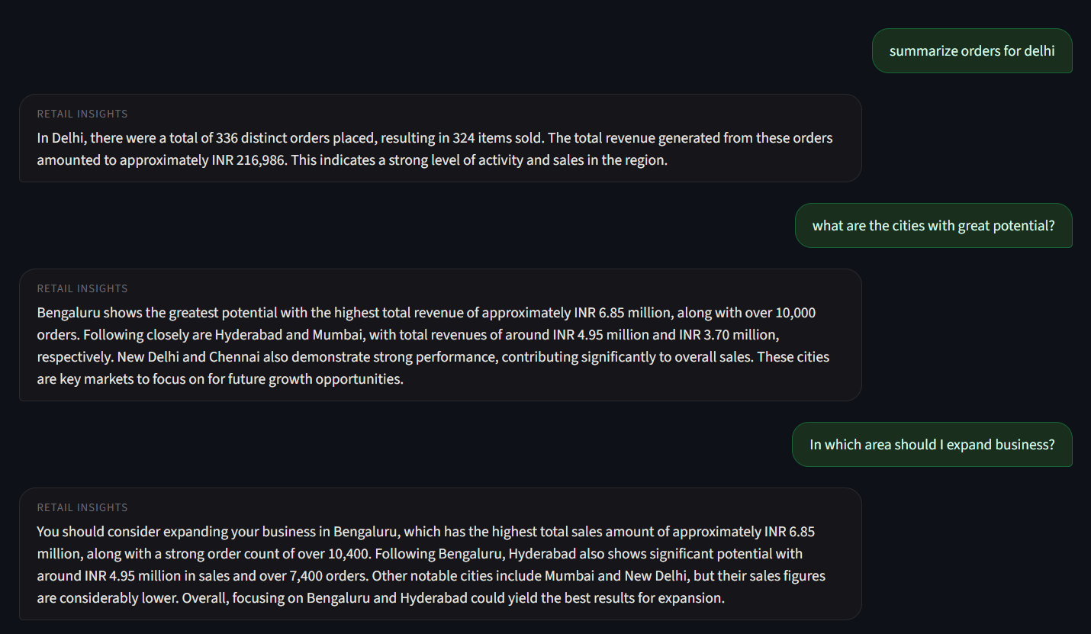

Slide 17
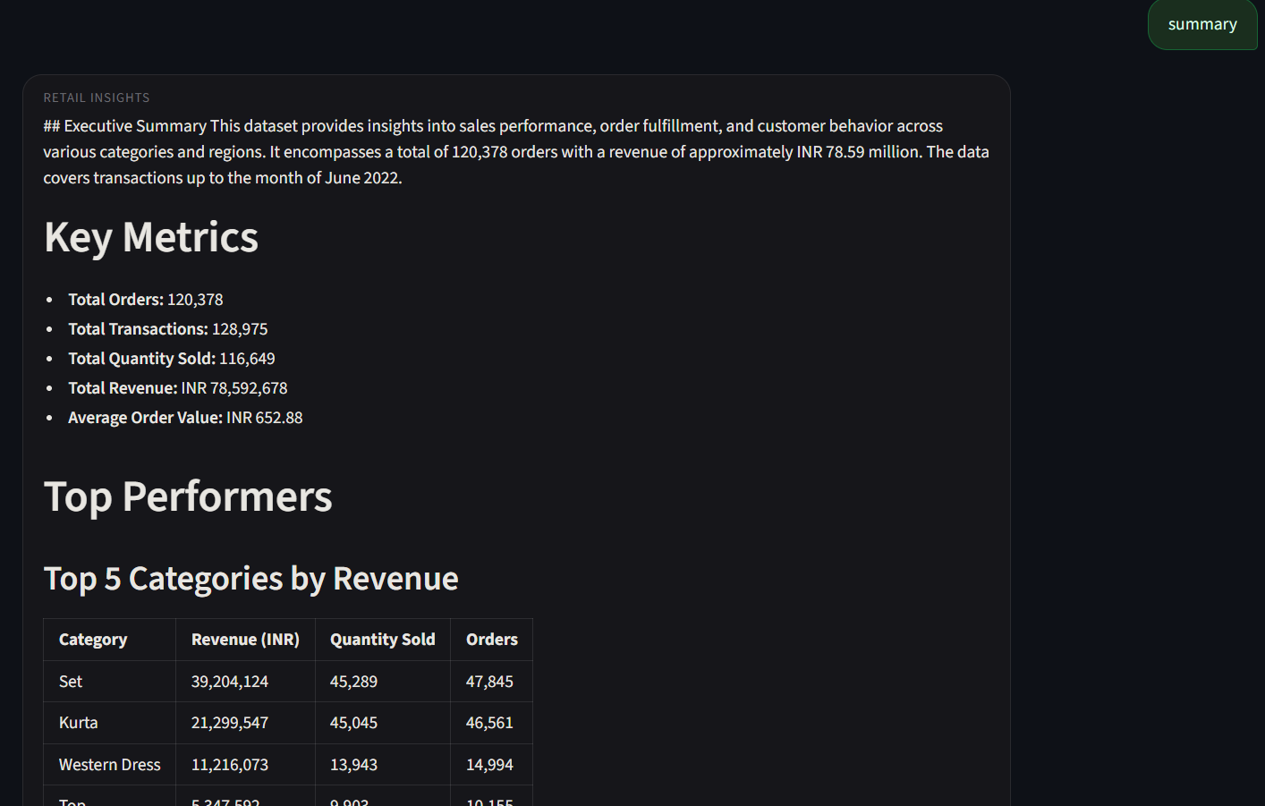

Slide 18
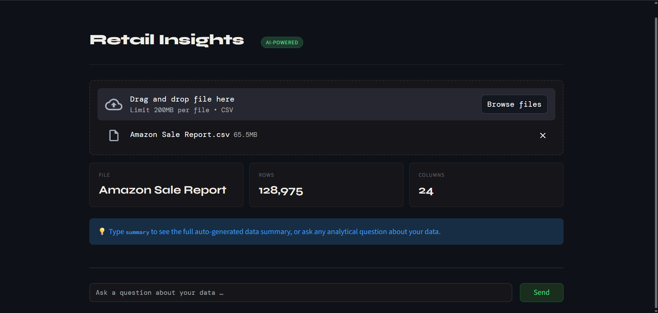

Slide 19
Thank You
By: Fardeen Alam

